Slide 1
Introduction to the Cell
(class 2)
Prof. John Dorband

Slide 2
Blade Cluster Architecture
MPI
NUMA SMP
Multi-thread
DM MIMD
SIMD

Slide 3

Cell Blade Hardware Overview
Blade
  Two Cell BE Processors
  1GB XDRAM
  BladeCenter Interface ( Based on IBM JS20)
Chassis
  Standard IBM BladeCenter form factor with:
    7 Blades (for 2 slots each) with full performance
    2 switches (1Gb Ethernet) with 4 external ports each
  Updated Management Module Firmware.
  External Infiniband Switches with optional FC ports.
Blade
Chassis
Blade
XDRAM
XDRAM
Cell
Processor
Cell
Processor
South
Bridge
South
Bridge
GbE
IB
4X
IB
4X
GbE
Typical Configuration (available today from E&TS)
  eServer 25U Rack
  7U Chassis with Cell BE Blades, OpenPower 710
  Nortel GbE switch
  GCC C/C++ (Barcelona) or XLC Compiler for Cell (alphaworks)
  SDK Kit on http://www-128.ibm.com/developerworks/power/cell/
BladeCenter Network Interface

Slide 4
Cell BE Processor Can Support Many Systems
Game console systems
Blades
HDTV
Home media servers
Supercomputers
XDR^{tm}
XDR^{tm}
XDR^{tm}
XDR^{tm}
Cell BE
Processor
Cell BE
Processor
IOIF
BIF
IOIF
XDR^{tm}
XDR^{tm}
XDR^{tm}
XDR^{tm}
XDR^{tm}
XDR^{tm}
Cell BE
Processor
Cell BE
Processor
IOIF
IOIF
BIF
SW
BIF
Cell BE
Processor
IOIF
IOIF
Cell BE
Processor
Cell BE
Processor
IOIF0
IOIF1
XDR^{tm}
XDR^{tm}
XDR^{tm}
XDR^{tm}
Notes:
Check for cluster configuration ... Configuration w/ switches

Slide 5
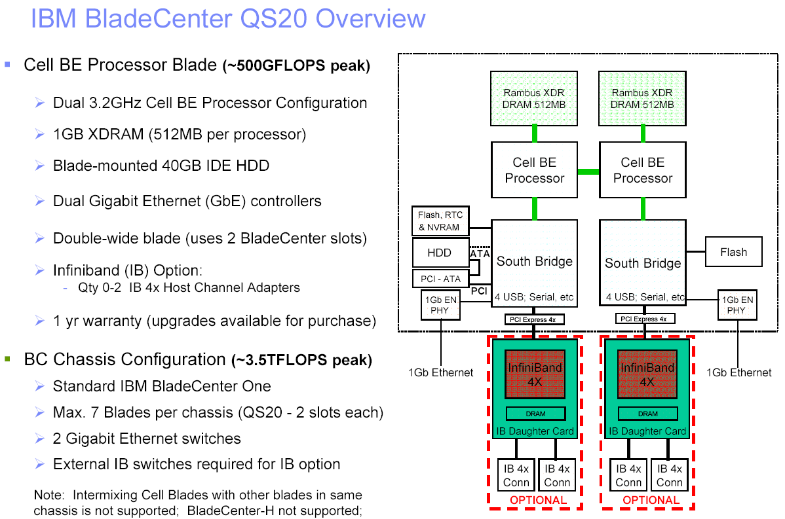

Slide 6
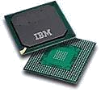
Cell Processor
25.6 GB/sec Memory Inteface
Synergistic Processor Elements (SPE):
8 per chip
128-bit wide SIMD Units
Integer and Floating Point capable
256KB Local Store
Up to 25.6 GF/s per SPE ---
200GF/s total *
“Supercomputer-on-a-Chip”
SPU
SPU
Power Processor Element (PPE):
General Purpose, 64-bit RISC
Processor (PowerPC 2.02)
2-Way Hardware Multithreaded
L1 : 32KB I ; 32KB D
L2 : 512KB
Coherent load/store
VMX
3.2 GHz
Local Store
Local Store
N
N
MFC
MFC
AUC
N
AUC
N
Element Interconnect Bus
Local Store
Local Store
AUC
AUC
MFC
SPU
* At clock speed of 3.2GHz
SPU
MFC
N
NCU
N
Power Core
(PPE)
Internal Interconnect:
Coherent ring structure
300+ GB/s total internal
interconnect bandwidth
DMA control to/from SPEs
supports >100 outstanding
memory requests
Local Store
AUC
AUC
Local Store
MFC
L2 Cache
MFC
SPU
SPU
N
N
20 GB/sec Coherent Interconnect
N
N
MFC
MFC
AUC
AUC
N
N
5 GB/sec I/O Bus
SPU
SPU
Local Store
Local Store
External Interconnects:
25.6 GB/sec BW memory interface
2 Configurable I/O Interfaces
  Coherent interface (SMP)
  Normal I/O interface (I/O & Graphics)
  Total BW configurable between interfaces
  Up to 35 GB/s out
  Up to 25 GB/s in
Memory Management & Mapping
SPE Local Store aliased into PPE system memory
MFC/MMU controls SPE DMA accesses
  Compatible with PowerPC Virtual Memory architecture
  S/W controllable from PPE MMIO
Hardware or Software TLB management
SPE DMA access protected by MFC/MMU

Slide 7
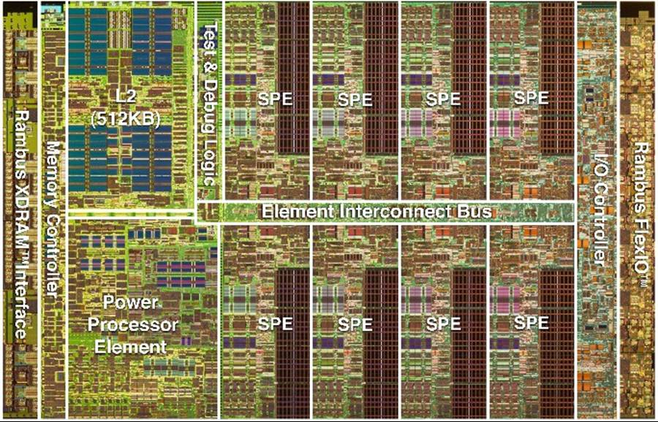
Cell Broadband Engine TM:
A Heterogeneous Multi-core Architecture
* Cell Broadband Engine is a trademark of Sony Computer Entertainment, Inc.

Slide 8
1 PPE core:
- VMX unit
- 32k L1 caches
- 512k L2 cache
- 2 way SMT

Slide 9
8 SPEs
-128-bit SIMD instruction set
- Register file – 128x128-bit
- Local store – 256KB
- MFC
- Isolation mode

Slide 10
Cell BE Block Diagram
SPE
SPU
SPU
SPU
SPU
SPU
SPU
SPU
SPU
SXU
SXU
SXU
SXU
SXU
SXU
SXU
SXU
LS
LS
LS
LS
LS
LS
LS
LS
MFC
MFC
MFC
MFC
MFC
MFC
MFC
MFC
EIB (up to 96B/cycle)
PPE
16B/cycle
16B/cycle
L2
PPU
MIC
BIC
L1
PXU
32B/cycle
16B/cycle
Dual XDRTM
FlexIOTM
64-bit Power Architecture with VMX

Slide 11
SPE Block Diagram
SPU Core: Registers & Logic
Channel Unit: Message passing interface for I/O
Local Store: 256KB of SRAM private to the SPU Core
DMA Unit: Transfers data between Local Store and Main Memory
SPE
SPU
SPU Core (SXU)
Channel Unit
Local Store
MFC
(DMA Unit)
To Element Interconnect Bus

Slide 12
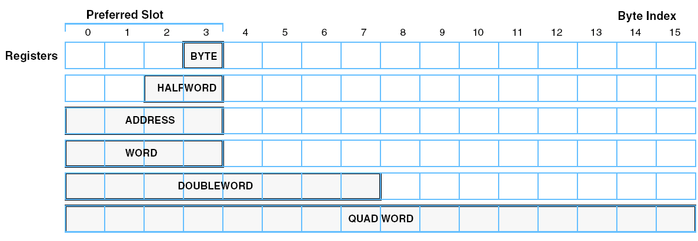
Register Scalar Data Layout
Preferred slot in bytes 0-3
  By convention for procedure interfaces
  Used by instructions expecting scalar data
    Addresses, branch conditions, generate controls for insert

Slide 13
Per SPE Resources (SPU Side)
SPU Direct Access Resources
128 - 128 bit GPRs
External Event Status (Channel 0)
Decrementer Event
Tag Status Update Event
DMA Queue Vacancy Event
SPU Incoming Mailbox Event
Signal 1 Notification Event
Signal 2 Notification Event
Reservation Lost Event
External Event Mask (Channel 1)
External Event Acknowledgement (Channel 2)
Signal Notification 1 (Channel 3)
Signal Notificaiton 2 (Channel 4)
Set Decrementer Count (Channel 7)
Read Decrementer Count (Channel 8)
16 Entry MFC Command Queue Interface (Channels 16-21)
DMA Tag Group Query Mask (Channel 22)
Request Tag Status Update (Channel 23)
Immediate
Conditional - ALL
Conditional - ANY
Read DMA Tag Group Status (Channel 24)
DMA List Stall and Notify Tag Status (Channel 25)
DMA List Stall and Notify Tag Acknowledgement (Channel 26)
Lock Line Command Status (Channel 27)
Outgoing Mailbox to PU (Channel 28)
Incoming Mailbox from PU (Channel 29)
Outgoing Interrupt Mailbox to PU (Channel 30)
SPU Indirect Access Resources
(via EA Addressed DMA)
System Memory
Memory Mapped I/O
This SPU Local Store
Other SPU Local Store
Other SPU Signal Registers
Atomic Update (Cacheable Memory)

Slide 14
Per SPE Resources (PPE Side)
Problem State
Privileged 1 State (OS)
Privileged 2 State
(OS or Hypervisor)
4K Physical Page Boundary
4K Physical Page Boundary
4K Physical Page Boundary
8 Entry MFC Command Queue Interface
DMA Command and Queue Status
DMA Tag Status Query Mask
DMA Tag Status
32 bit Mailbox Status and Data from SPU
32 bit Mailbox Status and Data to SPU
4 deep FIFO
Signal Notification 1
Signal Notification 2
SPU Run Control
SPU Next Program Counter
SPU Execution Status
SPU Master Run Control
SPU ID
SPU ECC Control
SPU ECC Status
SPU ECC Address
SPU 32 bit PU Interrupt Mailbox
MFC Interrupt Mask
MFC Interrupt Status
MFC DMA Privileged Control
MFC Command Error Register
MFC Command Translation Fault Register
MFC SDR (PT Anchor)
MFC ACCR (Address Compare)
MFC DSSR (DSI Status)
MFC DAR (DSI Address)
MFC LPID (logical partition ID)
MFC TLB Management Registers
SPU Privileged Control
SPU Channel Counter Initialize
SPU Channel Data Initialize
SPU Signal Notification Control
SPU Decrementer Status & Control
MFC DMA Control
MFC Context Save / Restore Registers
SLB Management Registers
4K Physical Page Boundary
4K Physical Page Boundary
Optionally Mapped 256K Local Store
Optionally Mapped 256K Local Store

Slide 15
Memory Flow Controller Commands
DMA Commands
Put - Transfer from Local Store to EA space
Puts - Transfer and Start SPU execution
Putr - Put Result - (Arch. Scarf into L2)
Putl - Put using DMA List in Local Store
Putrl - Put Result using DMA List in LS (Arch)
Get - Transfer from EA Space to Local Store
Gets - Transfer and Start SPU execution
Getl - Get using DMA List in Local Store
Sndsig - Send Signal to SPU
Command Modifiers: <f,b>
f: Embedded Tag Specific Fence
Command will not start until all previous commands
in same tag group have completed
b: Embedded Tag Specific Barrier
Command and all subsiquent commands in same
tag group will not start until previous commands in same
tag group have completed
Command Parameters
LSA - Local Store Address (32 bit)
EA - Effective Address (32 or 64 bit)
TS - Transfer Size (16 bytes to 16K bytes)
LS - DMA List Size (8 bytes to 16 K bytes)
TG - Tag Group(5 bit)
CL - Cache Management / Bandwidth Class
Synchronization Commands
Lockline (Atomic Update) Commands:
getllar - DMA 128 bytes from EA to LS and set Reservation
putllc - Conditionally DMA 128 bytes from LS to EA
putlluc - Unconditionally DMA 128 bytes from LS to EA
barrier - all previous commands complete before subsiquent
commands are started
mfcsync - Results of all previous commands in Tag group
are remotely visible
mfceieio - Results of all preceding Puts commands in same
group visible with respect to succeeding Get commands
SL1 Cache Management Commands
sdcrt - Data cache region touch (DMA Get hint)
sdcrtst - Data cache region touch for store (DMA Put hint)
sdcrz - Data cache region zero
sdcrs - Data cache region store
sdcrf - Data cache region flush

Slide 16
Element Interconnect Bus

Slide 17
System Memory Interface:
- 16 B/cycle
- 25.6 GB/s (1.6 Ghz)

Slide 18
MFC Detail
Memory Flow Control System
DMA Unit
  LS <-> LS, LS<-> Sys Memory, LS<-> I/O Transfers
  8 PPE-side Command Queue entries
  16 SPU-side Command Queue entries
MMU similar to PowerPC MMU
  8 SLBs, 256 TLBs
  4K, 64K, 1M, 16M page sizes
  Software/HW page table walk
  PT/SLB misses interrupt PPE
Atomic Cache Facility
  4 cache lines for atomic updates
  2 cache lines for cast out/MMU reload
Up to 16 outstanding DMA requests in BIU
Resource / Bandwidth Management Tables
  Token Based Bus Access Management
  TLB Locking
Isolation Mode Support (Security Feature)
Hardware enforced “isolation”
  SPU and Local Store not visible (bus or jtag)
  Small LS “untrusted area” for communication area
Secure Boot
  Chip Specific Key
  Decrypt/Authenticate Boot code
“Secure Vault” – Runtime Isolation Support
  Isolate Load Feature
  Isolate Exit Feature

Slide 19
Element Interconnect Bus (EIB)
- 96B / cycle bandwidth

Slide 20
Internal Bandwidth Capability
EIB data ring for internal communication
  Four 16 byte data rings, supporting multiple transfers
  96B/cycle peak bandwidth
  Over 100 outstanding requests
Each EIB Bus data port supports 25.6GBytes/sec* in each direction
The EIB Command Bus streams commands fast enough to support 102.4 GB/sec for coherent commands, and 204.8 GB/sec for non-coherent commands.
The EIB data rings can sustain 204.8GB/sec for certain workloads, with transient rates as high as 307.2GB/sec between bus units
* The above numbers assume a 3.2GHz core frequency – internal bandwidth scales with core frequency

Slide 21
Element Interconnect Bus - Data Topology
Four 16B data rings connecting 12 bus elements
  Two clockwise / Two counter-clockwise
Physically overlaps all processor elements
Central arbiter supports up to three concurrent transfers per data ring
  Two stage, dual round robin arbiter
Each element port simultaneously supports 16B in and 16B out data path
  Ring topology is transparent to element data interface
PPE
SPE1
SPE3
SPE5
SPE7
IOIF1
16B
16B
16B
16B
16B
16B
16B
16B
16B
16B
16B
Data Arb
16B
16B
16B
16B
16B
16B
16B
16B
16B
16B
16B
16B
16B
MIC
SPE0
SPE2
SPE4
SPE6
BIF/IOIF0
Notes:
Central arbiter supports up to three concurrent transfers per data ring
Two stage, dual round robin arbiter

Slide 22
Example of eight concurrent transactions
PPE
SPE1
SPE3
SPE5
SPE7
IOIF1
PPE
SPE1
SPE3
SPE5
SPE7
IOIF1
Ramp
7
Controller
Ramp
8
Controller
Ramp
9
Controller
Ramp
10
Controller
Ramp
11
Controller
Ramp
6
Ramp
7
Ramp
8
Ramp
9
Ramp
10
Ramp
11
Controller
Controller
Controller
Controller
Controller
Controller
Data
Arbiter
Ramp
7
Controller
Ramp
8
Controller
Controller
Ramp
2
Controller
Ramp
4
Controller
Ramp
3
Ramp
9
Controller
Ramp
10
Controller
Ramp
11
Controller
Controller
Ramp
5
Controller
Ramp
1
Controller
Ramp
0
Controller
Controller
Controller
Controller
Controller
Controller
Ramp
5
Ramp
4
Ramp
3
Ramp
2
Ramp
1
Ramp
0
MIC
SPE0
SPE2
SPE4
SPE6
BIF /
MIC
SPE0
SPE2
BIF /
PPE
SPE1
SPE3
SPE4
SPE5
SPE6
IOIF1
SPE7
IOIF1
IOIF0
Ring0
Ring1
controls
Ring2
Ring3

Slide 23
I/O and Memory Interfaces

Slide 24
I/O Interface:
- 16 B/cycle x 2

Slide 25
I/O and Memory Interfaces
I/O Provides wide bandwidth
  Dual XDRTM controller (25.6GB/s @ 3.2Gbps)
  Two configurable interfaces (76.8GB/s @6.4Gbps)
    Configurable number of Bytes
    Coherent or I/O Protection
  Allows for multiple system configurations

